Slide 1







Football Players Stats in Top 5 Leagues Performance Analysis Season 2024/25
Tapan Pradip Jadhav
IT Vedant, Andheri

Slide 2
Objective -
To analyze and visualize key performance metrics of Football Players from Top 5 European Leagues using Power BI.
Problem Statement -
Football clubs, scouts, and analysts require a data-driven insights to evaluate player performance, identify top scorers and understand trends across major European leagues to aid decision-making in recruitment process and match strategies.

Slide 3
Dataset Overviews -
Dataset Name: All Football Players Stats in Top 5 Leagues (2024–25)
Source: Kaggle [https://www.kaggle.com/datasets/orkunaktas/all-football-players-stats-in-top-5-leagues-2425 ]
Records Size: Rows (2642) & Columns (22)
Total Players: 2,642 | Total Nationalities: 89 Countries
Total Leagues: 5 | Total Clubs: 96 Football Clubs
Total Goals: 4,589 | Total Assists: 3,278
Yellow Cards: 6,796 | Red Cards: 311
*Note: Data cleaning and data transformations were done using Power BI tools.

Slide 4
Key Global Insights -
Barcelona (99) and Bayern Munich (96) scored the most goals.
Top 7 Goal Scorers: Kylian Mbappe (31), Salah (29), Lewandowski (27), Kane (26), Retegui (25), Isak (23) and Haaland (22) respectively.
Positive correlation found between Expected Goals and Actual Goals.
Top 5 Nations by Players:
1. Spain (402)
2. France (329)
3. Germany (223)
4. United Kingdom (214)
5. Italy (206)

Slide 5
Premier League -
Players: 554 | Clubs: 20
Goals: 1,068 | Assists: 796
Youngest Player: Harry Howell (15 yrs)
Oldest Player: Ashley Young (39 yrs)
Top 3 Scorers: Salah (29), Isak (23), Haaland (22)
Position Distribution: DF (33.94%), MF (19.86%), FW (15.34%)

Slide 6
Serie A League -
Players: 570 | Clubs: 20
Goals: 885 | Assists: 616
Youngest Player: Francesco Camarda (16 yrs)
Oldest Player: Pepe Reina (41 yrs)
Top Scorers: Retegui (25), Kean (19), Lookman (15)
Position Distribution: DF (34.04%), MF (23.51%), FW (12.81%)

Slide 7
Bundesliga -
Players: 451 | Clubs: 18
Goals: 897 | Assists: 646
Youngest Player: Viggo Gebel (16 yrs)
Oldest Player: Manuel Neuer (38 yrs)
Top Scorers: Kane (26), Schick (21), Guirassy (21)
Position Distribution: DF (30.82%), MF (19.73%), FW/MF (12.86%)

Slide 8
La Liga -
Players: 567 | Clubs: 20
Goals: 929 | Assists: 654
Youngest Player: David Otorbi (16 yrs)
Oldest Player: Luka Modric (38 yrs)
Top Scorers: Mbappe (31), Lewandowski (27), Budimir (21)
Position Distribution: DF (30.16%), MF (20.99%), FW (15.17%)

Slide 9
Ligue 1 -
Players: 500 | Clubs: 18
Goals: 810 | Assists: 566
Youngest Player: Djylian N'Guessan (15 yrs)
Oldest Player: Dante (39 yrs)
Top Scorers: Greenwood (21), Dembele (21), Kalimuendo (17)
Position Distribution: DF (31.2%), MF (18.8%), FW (14%)

Slide 10
Conclusion -
Power BI provided a dynamic and interactive way to extract insights from complex football datasets using following visuals; Bar charts, Donut charts, Map visuals, Decomposition Tree, Smart Narrative and Key Influencers.
Key Takeaways -
Top 5 Clubs by Goals: Barcelona, Bayern Munich, PSG, Real Madrid and Arsenal.
Most Influential Positions: Defenders lead in player count.

Slide 11

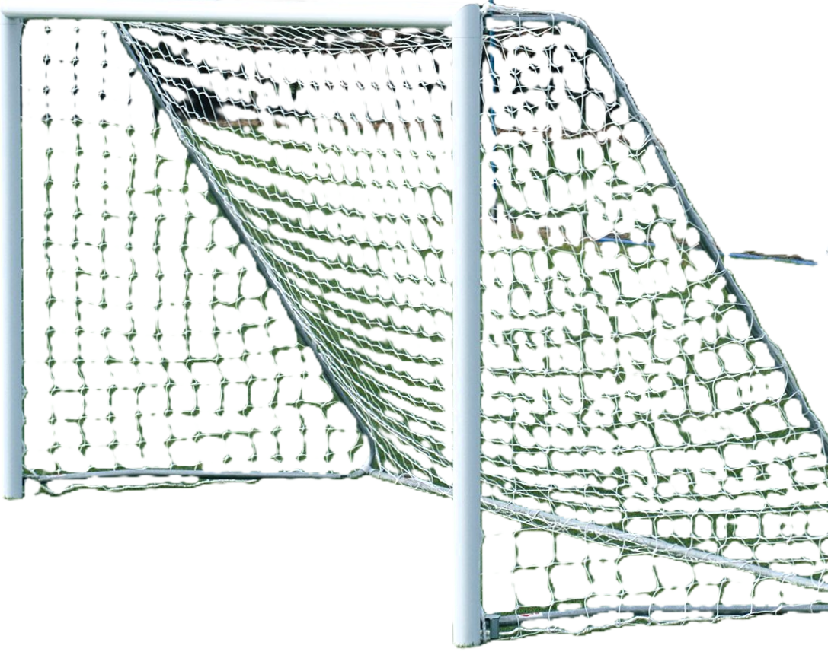
~ THANK YOU ~

